Slide 1
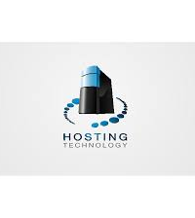
Server Technologies 1. Shared Server
Shared hosting is a type of web hosting where a single physical server hosts multiple sites. Many users utilize the resources on a single server, which keeps the costs low. Users each get a section of a server in which they can host their website files. Shared servers can hosts hundreds of users.

Slide 2

2.Dedicated Server
A dedicated server is a type of remote server that is entirely dedicated to an individual, organization or application. It is deployed, hosted and managed by a hosting, cloud or managed service provider (MSP).
A dedicated server is exclusive and not shared with any other customer, service or application.

Slide 3
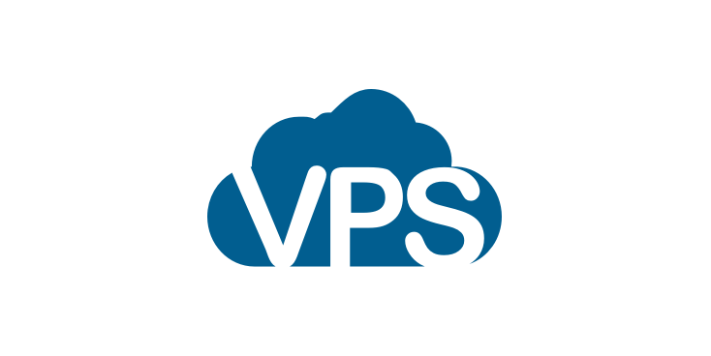
3.VPS
Virtual Private Server hosting, aka VPS hosting, is a website hosting environment that allows for resources such as RAM and CPU to be dedicated to your account. This is achieved by virtualising a Dedicated server and splitting the resources amongst the users on that server.

Slide 4
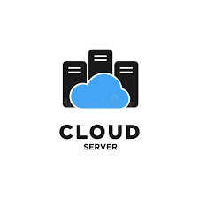
4. Cloud
A cloud server is a pooled, centralized server resource that is hosted and delivered over a network—typically the Internet—and accessed on demand by multiple users. Cloud servers can perform all the same functions of a traditional physical server, delivering processing power, storage and applications.

Slide 5
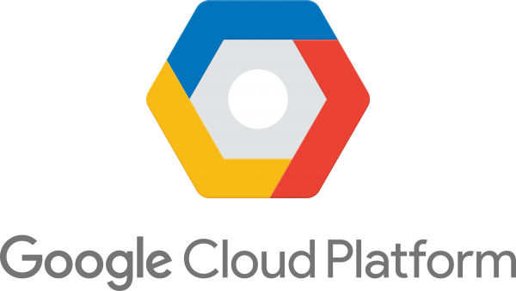
5. Google Cloud Platform (GCP)
Google Cloud Platform (GCP), offered by Google, is a suite of cloud computing services that runs on the same infrastructure that Google uses internally for its end-user products, such as Google Search, Gmail, Google Drive, and YouTube.

Slide 6
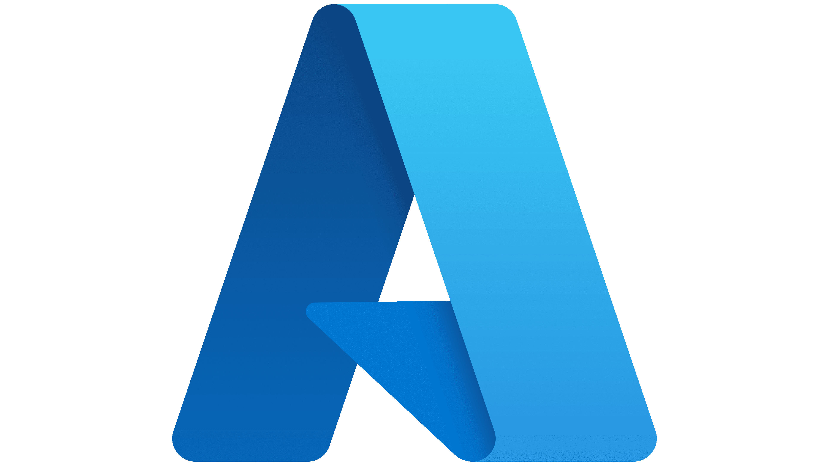
6. Azure
Azure is a cloud computing platform and an online portal that allows you to access and manage cloud services and resources provided by Microsoft. These services and resources include storing your data and transforming it, depending on your requirements.

Slide 7

7. Amazon Web Service (AWS)
Amazon web service is an online platform that provides scalable and cost-effective cloud computing solutions. AWS is a broadly adopted cloud platform that offers several on-demand operations like compute power, database storage, content delivery, etc., to help corporates scale and grow.

